Slide 1

Toby’s Signature Cakes and Pastries
By: Hazam Chiquito and Nezreel Andrei Catipay

Slide 2
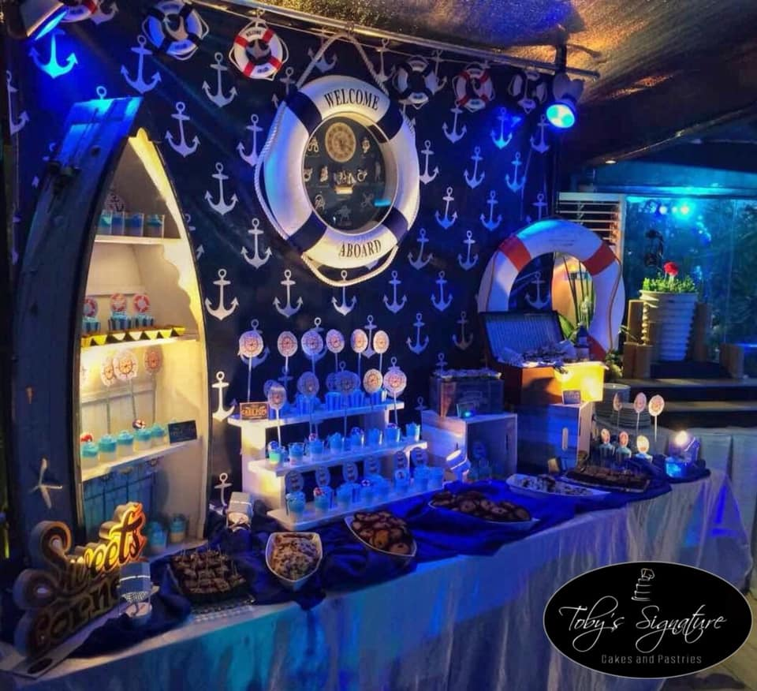
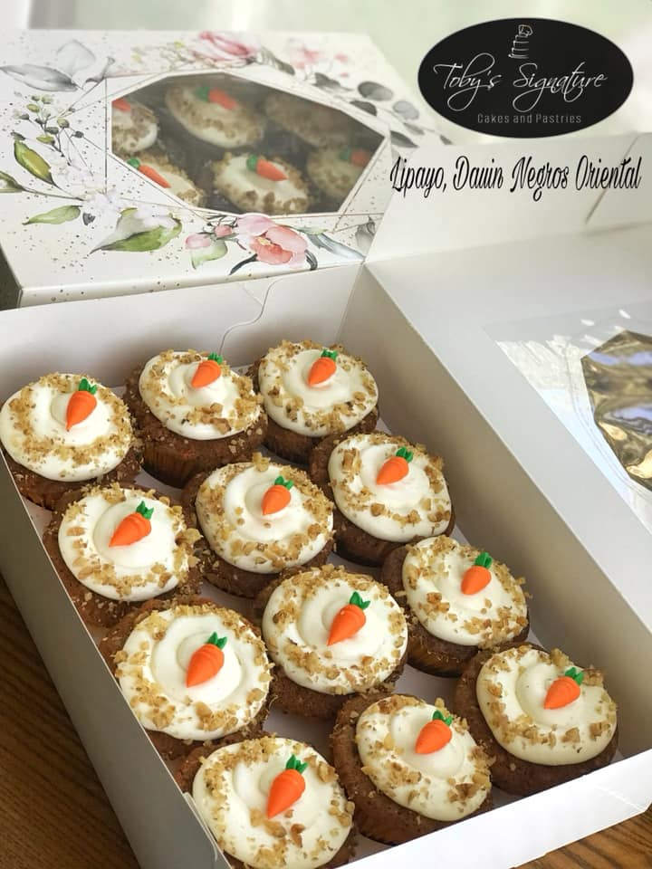
Purpose Of the Website
- To provide customers a much easier and convenient way to view and select products to purchase.
- To provide customers with reviews.
- To provide the shop a convenient way to manage orders and updates of their customers.
Target Users
- The target users for this website will appeal to all households and residents. Especially people who need a cake for a birthday or a wedding or other events.

Slide 3

Team Name
Website Category
Team PENGUIN
eCommerce Website
- it can make users shop online like selecting and purchasing products with product descriptions. It will also provide information about the business.
Team Logo

Slide 4

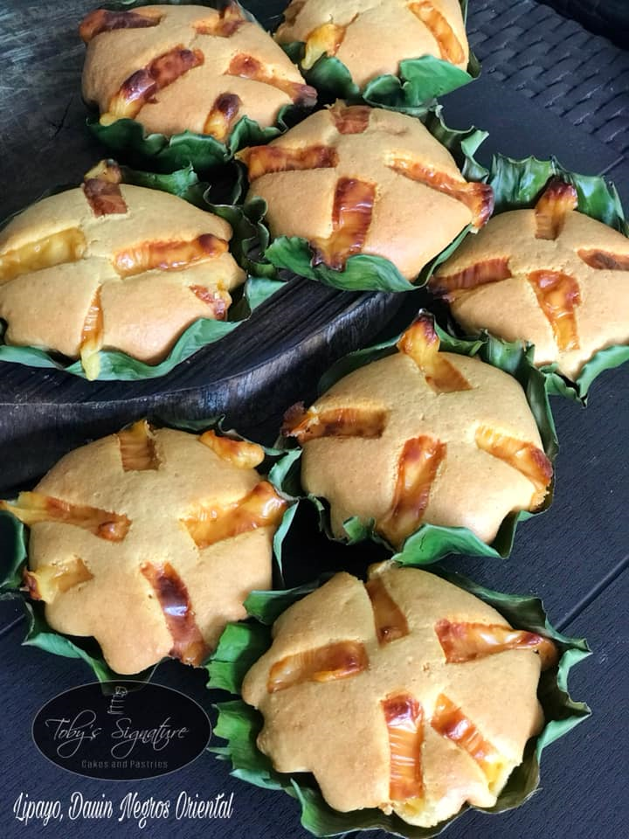
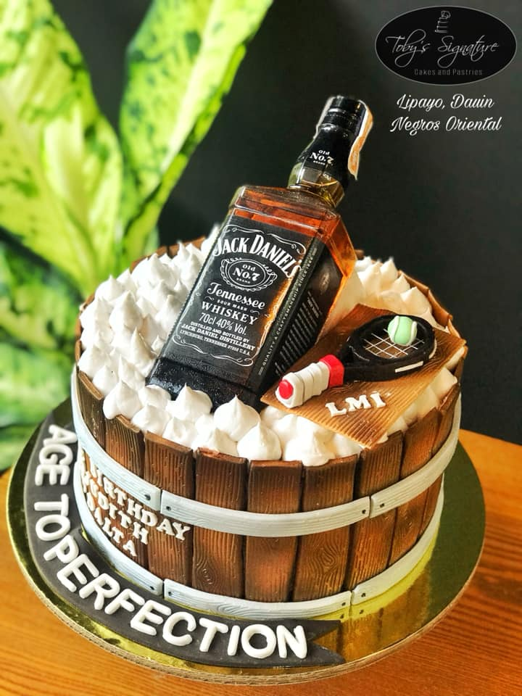
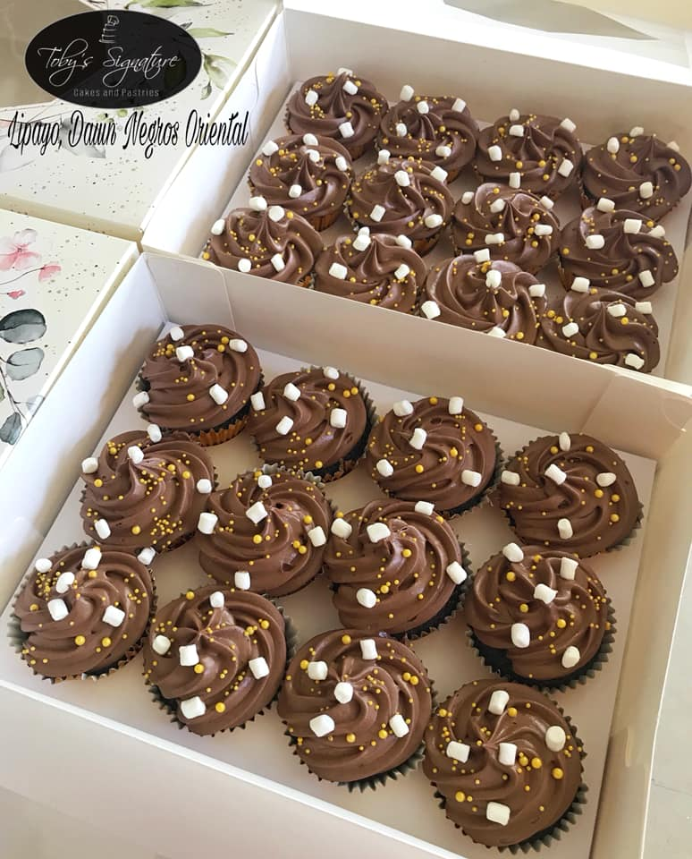
PHP
Toby’s Signature Cakes and Pastries
PHP

